Slide 1

BEST PRACTICES WITH REACT

Slide 2

Lesson Outline
React is just a view library
Keep your components small
Class based components
Functional Components
Conditionals in JSX
Write stateless components
Use Redux.js
Use shallow rendering

Slide 3

Cont.
Prop transformations
User interaction
Integration testing
Avoid TDD when writing React components
Embrace JSX and the components-based future of the web
Directory layout
Higher order components

Slide 4
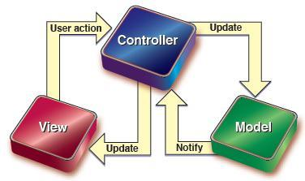
I - React is just a view library
React is not an MVC framework - it is simply a library for rendering your views.
React represents the V part of the MVC equation (Model View Controller).
And so you need to use other platforms to define the M and C.
Using React for both M, V and C will yield some really yucky React code.

Slide 5

II - Keep your components small
Keeping your all components small makes them easier to understand, test and maintain.
The size depends on many factors, but the general target should be to keep the components smaller than you think they should be.

Slide 6
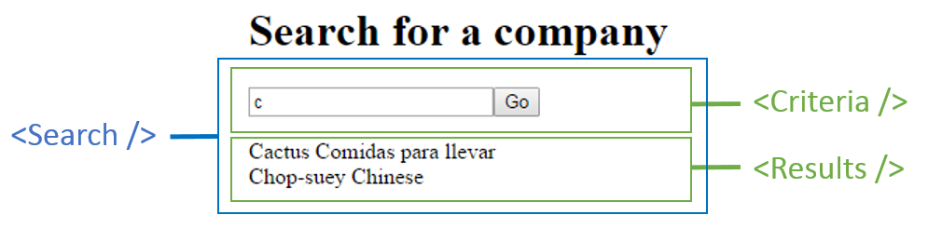
III - Class based components
Class based components should be used very sparingly. We shall go line by line on how to build such components.

Slide 7
Importing CSS
import React, { Component } from 'react'
import { observer } from 'mobx-react'
import ExpandableForm from './ExpandableForm'
import './styles/ProfileContainer.css'

Slide 8
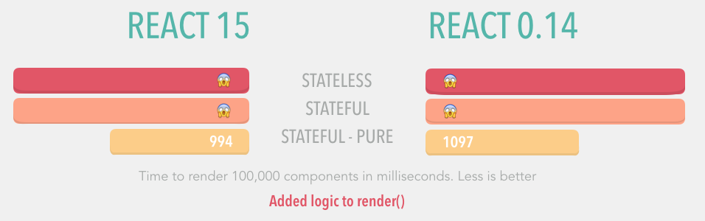
Using CSS in Javascript is a new idea, and thus has not been fully developed.
Therefore, we choose to import a CSS file for each component.
Dependency imports from local imports should also be separated by a new line.

Slide 9
Initializing state
import React, { Component } from 'react'
import { observer } from 'mobx-react'
import ExpandableForm from './ExpandableForm'
import './styles/ProfileContainer.css'
export default class ProfileContainer extends Component {
state = { expanded: false }
As a good practice, we export our class as the default.

Slide 10
proTypes and defaultProps
import React, { Component } from 'react'
import { observer } from 'mobx-react'
import { string, object } from 'prop-types'
import ExpandableForm from './ExpandableForm'
import './styles/ProfileContainer.css'
export default class ProfileContainer extends Component {
state = { expanded: false }
static propTypes = {
model: object.isRequired,
title: string
}
static defaultProps = {
model: {
id: 0
},
title: 'Your Name'
}

Slide 11
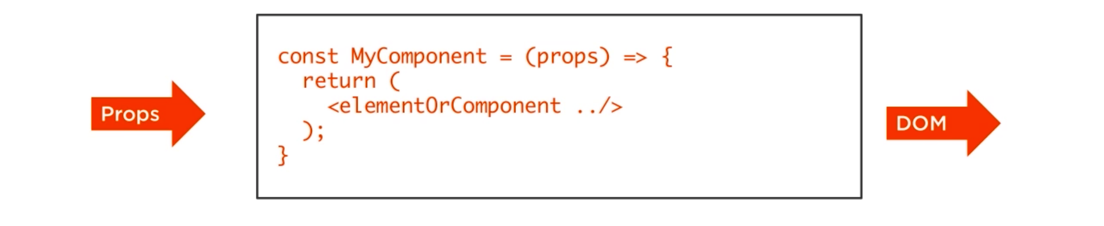
Being static properties, propTypes and defaultprops should be declared as high as possible within the component code.
Other devs should instantly notice them while reading the file because they serve as documentation.
In case you are using React 15.3.0 or higher, go for the prop-types package instead of React.PropTypes, since they are nicely destructured.
In fact, all the components should include propTypes.

Slide 12
Methods
The best practice with class components is ensuring they have the right this when passing methods to subcomponents.
You do this by passing this.handleSubmit.bind(this) to the subcomponent.
This is a cleaner and easier approach since it maintains the correct context automatically via the ES6 arrow function.

Slide 13
Passing setState a Function
this.setState({ expanded: !this.state.expanded })
The setState is asynchronous.
The state may not be changed instantly when the setState is called since the React batches state changes for performance reasons.
For this reason, you ought not to rely on the current state when calling setState - because you can’t be sure what that state will be.
So what is the solution?
Pass a function to setState, with the previous state as an argument.
this.setState(prevState => ({ expanded: !prevState.expanded }))

Slide 14

Destructuring props
Each prop should start on a new line

Slide 15
Decorators
@observer
export default class ProfileContainer extends Component {
Decorators are one flexible and easy way of modifying component functionality. Decorators are used extensively with mobx and the mobx-models library.
When using mobx, you may decorate the class component as shown above. This is the same as passing the component into a function.
For one reason or another you may not like the decorator. You have the option shown below:
@observer
export default class ProfileContainer extends Component {

Slide 16
Closures
Refrain from passing new closures to subcomponents.
This is so because, everytime the parent component renders, a new function is created and passed to the input.
Assume the input was a react component. It would by default trigger it to re-render, not caring whether its other props have been altered.
The above saves us the pain of reconciliation, which is very expensive and time consuming.
Passing class methods also makes the code easier to read, debug and change.

Slide 17
<input
type="text"
value={model.name}
// onChange={(e) => { model.name = e.target.value }}
// ^ Not this. Use the below:
onChange={this.handleChange}
placeholder="Your Name"/>

Slide 18

IV - Functional components
These are components with no state nor methods.
They are normally easy to comprehend, reason you should use them as much as possible.

Slide 19
propTypes
import React from 'react'
import { observer } from 'mobx-react'
import { func, bool } from 'prop-types'
import './styles/Form.css'
ExpandableForm.propTypes = {
onSubmit: func.isRequired,
expanded: bool
}
// Component declaration
We have assigned the propTypes before declaring the component. This makes them immediately visible. JavaScript function hosting makes this possible.

Slide 20
Destructuring Props and defaultProps
We can still use default arguments to act as defaultProps . In case expanded is not defined, we assign it a false.
Below is an ES6 syntax to avoid:
const ExpandableForm = ({ onExpand, expanded, children }) => {
This function is unnamed. This should not be an issue if your Babel is correctly set up. If not, any errors will be said to occur in <<anonymous>>. This will cause a real headache to debug.
When testing with Jest, unnamed functions can also bring problems. To avoid such “anonymous bugs”, we can use function in place of const.

Slide 21
import React from 'react'
import { observer } from 'mobx-react'
import { func, bool } from 'prop-types'
import './styles/Form.css'
ExpandableForm.propTypes = {
onSubmit: func.isRequired,
expanded: bool,
onExpand: func.isRequired
}
function ExpandableForm({ onExpand, expanded = false, children, onSubmit }) {
const formStyle = expanded ? {height: 'auto'} : {height: 0}
return (
<form style={formStyle} onSubmit={onSubmit}>
{children}
<button onClick={onExpand}>Expand</button>
</form>
)
}

Slide 22
Wrapping
We cannot use decorators with functional components. The best thing to do is pass the decorator as a function in the argument.
import React from 'react'
import { observer } from 'mobx-react'
import { func, bool } from 'prop-types'
import './styles/Form.css'
ExpandableForm.propTypes = {
onSubmit: func.isRequired,
expanded: bool,
onExpand: func.isRequired
}

Slide 23
function ExpandableForm({ onExpand, expanded = false, children, onSubmit }) {
const formStyle = expanded ? {height: 'auto'} : {height: 0}
return (
<form style={formStyle} onSubmit={onSubmit}>
{children}
<button onClick={onExpand}>Expand</button>
</form>
)
}
export default observer(ExpandableForm)

Slide 24
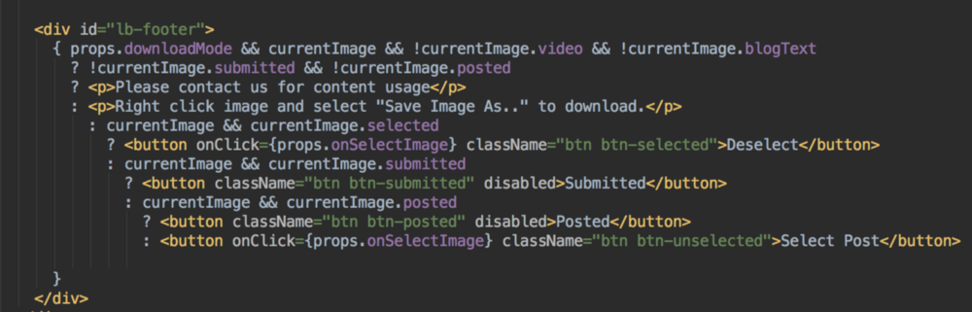
V - Conditionals in JSX
Using React involves a great deal of conditional formatting. Avoid nested tertiaries as used in the code below:

Slide 25
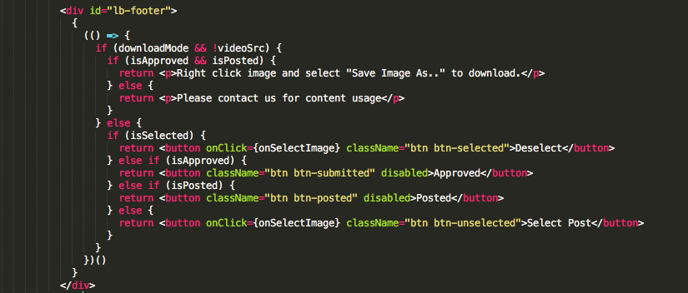
The code below will be the best approach for such complex conditions.

Slide 26
VI - Write stateless components
State makes components difficult to test
The best to test is pure data-in-data-out functions. Adding state to the components makes them more difficult to test.
To test stateful components, we will first need to get the components into the right state so as to test their behaviour.
Also, we will have to go the extra mile of generating all the possible combinations of state and props and decide which one to test, and how to test it.

Slide 27

State makes components difficult to comprehend
When a component is full of states, you have to really overwork mentally to be able to follow the code.
You will be asking questions like,
“Have we initialised the state yet?
What is the result of changing this state at this juncture?
Where else is the state changed? Is there a race condition on such and such a state?”
This literally wears you out.

Slide 28
State makes it too easy to put business logic in the component
We should generally not have to search through components to determine behaviour.
React is basically a view library. Render logic should be the priority. Business logic is not something to be concerned of.
When you include a lot of state in the component (which you can easily acces by the function this.state, you may be tempted to add calculations or validation into the component, and this is wrong.
This ends up making testing really hard. There is normally no way to test render logic without the business logic getting in the way.

Slide 29
State makes sharing of information to other parts of the app an uphill task
When a component includes a state, it becomes easy to pass it further down the component hierarchy. Any other direction apart from this is not so straightforward.
Sometimes it is pretty okay for a particular component to totally own a particular piece of state. In this situation you can use this.setState. This is a legitimate part of the React component API, and should be used when need be.
Take the example of a user typing into a field. Is it sensible to expose every keypress to the whole app? No. The field can track its own intermediate state until a blur event happens. It is only the final value which will be sent out to become state stored somewhere else.
Be very conscious every time you add state to a component.

Slide 30

VII - Use Redux.js
As earlier stated, React is basically a view Library. You therefore are wondering where to put all the state and logic.
Flux is an architecture for designing web applications, most of which use React for rendering. The best framework that implements the ideas of Flux is Redux.

Slide 31
Redux works as follows:
Components are assigned callback functions as props. The props are called when a UI event happens.
Actions are thus created and dispatched depending on the event.
Reducers process the actions and compute the new state.
The state of the entire application goes into one single store.
Components receive the new state as props and re-render themselves where needed.

Slide 32
Advantages of Redux
Reducers are pure functions. Their basic structure is oldState + action = newState. Each Reducer works on a specific piece of state.
This makes all business logic and state transitions easy to test.
The API is tinier and simpler, and well documented. It is one of the easiest concepts to learn.
A good use of Redux ensures only a very small number of components depend on Redux. The other components simply receive state and callbacks as props. The components therefore remain simple, with reduced framework lock-in.

Slide 33

VIII - Use shallow rendering
Testing React components remains a difficult topic. It is still under research and therefore no single method has been proven the best one. One of the best is use shallow rendering and prop assertions.
Shallow rendering enables you to render one component thoroughly without getting into its child components. The resulting object will reveal things like the type and props of the children. This gives us good isolation and allows testing of one component at a time.
Outlined below are two popular types of
component unit tests:

Slide 34
Render logic
describe('Image', () => {
it('renders a loading icon when the image is loading', () => {
const image = shallowRender(<Image loading={true}/>);
expect(image.type).toEqual(LoadingIcon);
});
it('renders the image once it has loaded', () => {
const image = shallowRender(<Image loading={false} src="https://example.com/image.jpg"/>);
expect(image.type).toEqual('img');
});
});

Slide 35
Test 2
describe('ListOfNumbers', () => {
it('renders an item for each provided number', () => {
const listOfNumbers = shallowRender(<ListOfNumbers className="red" numbers={[3, 4, 5, 6]}/>);
expect(listOfNumbers.props.children.length).toEqual(4);
});
});

Slide 36
IX - Prop transformations
As earlier mentioned, the children of the components are tested to ensure they were rendered correctly.
The children must have been given the correct props.
This is helpful in case a component does more transformation on its props, before passing them on.
the following component for instance.
CSS class names are taken as an array of strings and are passed down as a single, space-separated string.

Slide 37
const TextWithArrayOfClassNames = props => (
<div>
<p className={props.classNames.join(' ')}>
{props.text}
</p>
</div>
);
describe('TextWithArrayOfClassNames', () => {
it('turns the array into a space-separated string', () => {
const text = 'Hello, world!';
const classNames = ['red', 'bold', 'float-right'];
const textWithArrayOfClassNames = shallowRender(<TextWithArrayOfClassNames text={text} classNames={classNames}/>);
const childClassNames = textWithArrayOfClassNames.props.children.props.className;
expect(childClassNames).toEqual('red bold float-right');
});
});

Slide 38

Many have criticised this approach to testing due to the proliferation of props.children.props.children.
When you find yourself writing props.children too much in one test, this points to the component being too big, too complex, or deeply nested and should therefore be split up.
The tests also become become too dependent on the internal implementation of the component, and therefore changing the DOM structure causes all the tests to break.
This is avoided by keeping the components simple and small.

Slide 39
X - User interaction
Components are not just for display - they’re also interactive. Have a look at the following component:
const RedInput = props => (
<input className="red" onChange={props.onChange} />
)
Here’s how to test the above:

Slide 40
describe('RedInput', () => {
it('passes the event to the given callback when the value changes', () => {
const callback = jasmine.createSpy();
const redInput = shallowRender(<RedInput onChange={callback}/>);
redInput.props.onChange('an event!');
expect(callback).toHaveBeenCalledWith('an event!');
});
});

Slide 41
XI - Integration testing
To make sure your application connects up properly and functions well, you will need some higher level tests. Note these two things that you should do:
Render the whole tree of components - as opposed to tree rendering
Get into the DOM to locate the elements that concern you most - i.e. by using React TestUtils, or jQuery.
Assert on their HTML attributes or contents
Simulate DOM events, and then assert on the side effects - such as DOM or route changes, AJAX calls, etc

Slide 42
XII - Avoid TDD when writing React components
Avoid TDD when writing React components. When working on a component, try to land on the simplest HTML and CSS that looks right in any browser you need to support.
When TDD is used, unit testing of components will require constant fixing of the tests as you tweak the DOM.
This ends up consuming too much time.
The tests should also be so simple so that the advantages of test first are minimized.
The complex logic and transformations are then pulled out into action creatore and reducers. This is where TDD becomes beneficial.

Slide 43
XIII - Embrace JSX and the components-based future of the web
Aim at mixing your view and controller elements into a single file. You may consider mixing HTML and JavaScript principles, given that React is concerned with only the view layer.
It is good to not that JSX is not a templating language - it is a DSL (Domain Specific Language) over JavaScript - it only looks like HTML superficially.
The HTML syntax is included just to make programming easier. When you want to render a piece of the DOM, directly “declare its HTML” within the JavaScript: Below is a sample code:
In case you desire to know what library or framework specific syntax was required to create a new element and render it, simply return its HTML equivalent. This produces a more readable and understandable code.

Slide 44
XIV - Directory Layout
A component-centric file layout is be the best option.
components
└── FilterSlider
├── __tests__
│ └── FilterSlider-test.js
├── FilterSlider.jsx
└── FilterSlider.scss

Slide 45
XV - Higher Order components
One time or the other you have to make sure that a React component is only displayed when a user logs in to your application.
To start with, you will perform some sanity checks in your render method until you notice you’re repeating yourself a lot.
You will probably start drying up the code. You may end up with higher order components which help you extract certain elements of a component.
A higher order component is simply a function which receives a React component as a parameter and returns another React component.

